Slide 1

RESTAURANT BILLING SYSTEM
Sustainable Goal: ONLINE SHOPPING STORE APP
Project Mentor : Mrs. Sujata Khandaskar
Group Number : 2
Group Members : Jayesh Repale – D7A -72
Pratik Sawlani – D7C – 64
Gaurav Amarnani – D7A –67
Kritika Yadav – D7A - 73

Slide 2
Content
Introduction
Problem Definition
Goals
Survey of Existing System
Limitation Existing system or research gap
Proposed System: Introduction
Architecture/ Framework (Block Diagram, Conceptual Diagram, ER Diagram)
Algorithm and Process Design
Details of Hardware & Software
Methodology employed
Next Work Plan
Conclusion
References

Slide 3
Introduction to Project
This project will be based on giving final bill to customer of the restaurant. It will have a user-friendly GUI, which simply calculates the total as per particulars.
Restaurant Billing System using python can be very useful within a business environment.
While using this billing management system, you can easily calculate total bill of the customer. Moreover, the total bill is calculated including service charges and state tax.
This system can be used in restaurants, cafe and food truck for calculating bills in a short period of time and it’s not time consuming.

Slide 4
Problem Definition
This project will contain the menu and then adds up the selected items by customer and sums up the total of all items adds tax and service charges and displays total.
All you need to do is just fill up the blank boxes with item quantities and click on total button. The program will display your total bill with tax and charges.
With computer systems becoming more affordable, we can use them in our daily activities to ease our life.
It is typical for the one (Manager) to jot down each items consumed by customers and bill it up altogether.

Slide 5
Goals
The main goals of our Restaurant Billing System are :
To enable the employee of the restaurant to generate bill including all types of taxes and charges very easily.
A restaurant billing software allows ease of billing transactions to make the process simpler and quicker.
Minimum time needed for the various processing.

Slide 6
Literature Survey
Survey of existing system:
Sr No. | Reference of Research. | Features Impression
1. | Prof. Dashrath Kale, Girish Tanna, Mannat Tanna, Tarun Aswani4, Tejal Thadani, Aniruddha Thakur, “RESTAURANT BILLING SYSTEM USING PYTHON” International Research Journal of Engineering and Technology (IRJET), e-ISSN: 2395-0056, p-ISSN: 2395-0072, Volume: 08 Issue: 04 | Apr 2021 | Bill Generation Algorithm.
2. | Prof. N. M.Yawale#1, Prof. N. V. Pardakhe#2 , Prof. M. A. Deshmukh#3, Prof. N. A.Deshmukh#4 “A Review Paper on Online Restaurant Management System” IAETSD JOURNAL FOR ADVANCED RESEARCH IN APPLIED SCIENCES, ISSN NO: 2394-8442, VOLUME 4, ISSUE 7, DEC/2017 | Best Seller Recommendations.

Slide 7
Limitation of Existing system
We think that it will be a good addition if we could provide auto backup.
The existing system can be improved by adding Graphical Representation.
The existing system can be enhanced by adding encryption for user & owner information.

Slide 8
Proposed System
We have learned the basics of Python and wanted to learn more about GUI, Database Management, Graphical Representation using Python Libraries.
We are thinking of providing a subscription based model for the owners of restaurants where they can get analytical data about their best selling dishes.
We are thinking of providing an interface for customers to sign up and login for every business and users could get benefits like getting chosen for discounts and special offers. Owners in return can do marketing to the customers who have signed up.
We are thinking of encrypting all the data before storing it into the database so there is no issue even during data breach from database as you cannot decrypt certain encrypted data.
We are thinking of providing a data backup to all our Owners in case of any data loss under any circumstances just to be extra careful. The backup database can be used under situations of need.
We are thinking of providing Owners with Graphical Representation for profits or loss made on daily basis (which can be anything from achieving a daily/monthly set target by owner or whatever the owner prefers).

Slide 9
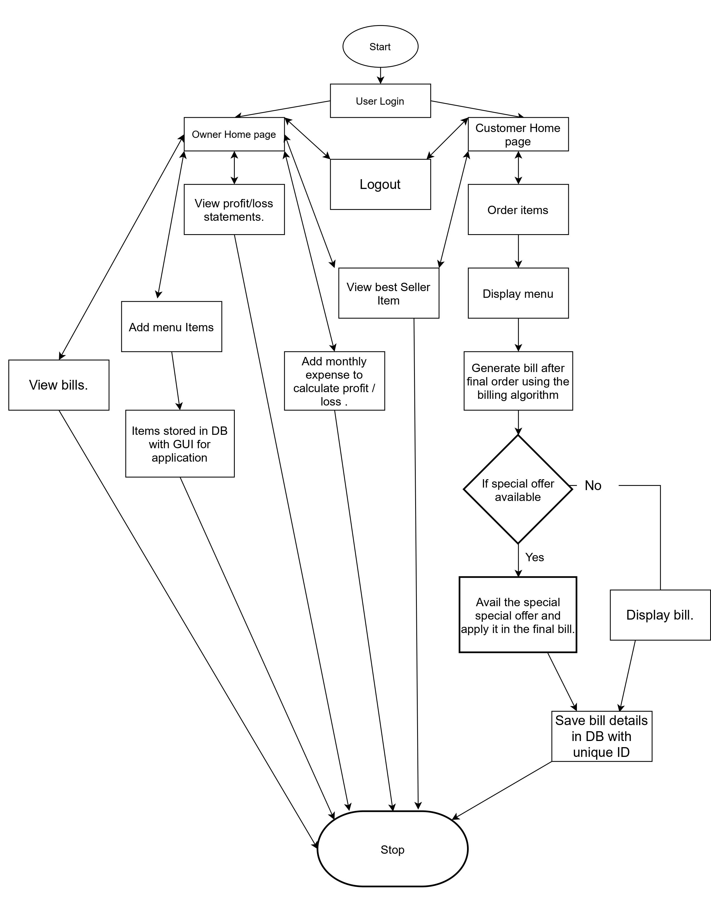
Architecture/ Framework (Flowchart)

Slide 10
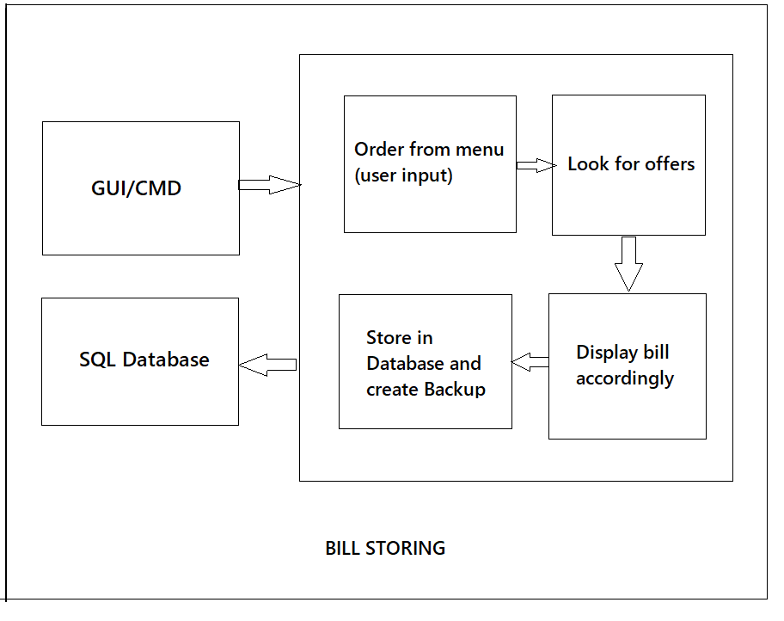
Architecture (Block Diagram)

Slide 11
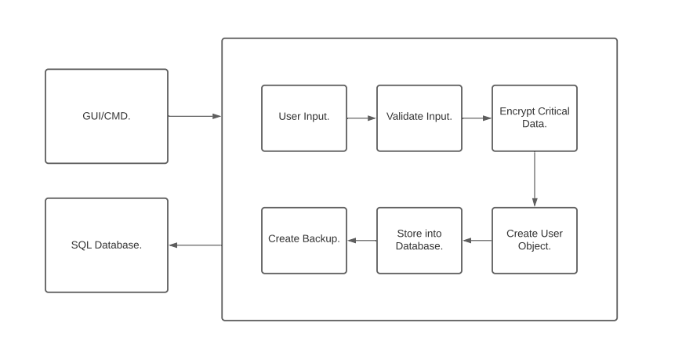
Architecture (Block Diagram)

Slide 12
Methodology : Algorithm and Process Design
1. Start.
2. Login or sign up and Login.
3. Owner login.
3.1 Owner can view profit and loss statements.
3.2 Owner can add monthly expenses.
3.3 Owner can view best sellers.
3.4 Owner will be provided with an interface and then the details will be encrypted and stored into database.
3.5 Owner can log out by simply clicking on log out button.
4. Customer login.
4.1 Customer can view best sellers.
4.2 Customer will get a menu.
4.2.1 Customer can order.

Slide 13
Methodology : Algorithm and Process Design
4.2.2 A bill will be generated using Bill Generation Algorithm.
4.2.3 If the customer gets lucky he/she will get special offer or theirs final bill will be displayed.
4.2.4 Bill will be stored into database with an unique ID.
4.2.5 Customer can log out.
5. Stop.

Slide 14
Hardware, Software, Tools and constraint
Hardware Requirements
Processor: Intel i5
Basic Intel GPU
Windows 10
4GB RAM (Minimum of 128 MB of memory)
Software Requirements and Tools
Python IDE
VS Code.

Slide 15
Next Work Plan
We plan on starting to study python step by step to built this project and start exploring all the libraries for GUI development like tkinter.
We plan on looking for possible ways to encrypt the database.
We plan on doing more research about this project topic by attending online meetings.
We plan on clearing our core python topics to built program for this project.

Slide 16
Conclusion
As from the research we understood that, a billing software works as a heartbeat of a retail business. It ensures that your business runs smoothly and efficiently, thereby reducing the operational costs.

Slide 17
References
A.R.Al-Ali and M. AL-Rousan. “Java-Based Home Automation System”. IEEE Transaction on Consumer Electronics, Vol.50, No. 2, May 2004.
Ching-suchang, Che-chen Kung, Tan-hsu Tan,” Development and Implementation of an E-Restaurant for Customer-Centric Service Using Wlan And Rfid Technology”, proceedings of the Seventh International Conference On Machine Learning And Cybernetics, Kunming, 12-15 July 2008
Cotta, M.A., Devidas, M.N.T., Dias, M.A., Kalidas, M.S.N. and Tanaji, M.R.A., Smart Restaurant Menu Ordering System.

